Slide 1
Comparing Fractions
Miss L
Year 7

Slide 2

Fraction Match Game
Materials and procedures
Provide pairs of students with Activity 2: Fraction match and a pair of scissors to create a set of cards.
The aim of the game is to be the first player to use all the cards in their hand.
Shuffle the cards and deal out seven cards to each player. Place the remaining cards face down, in a pile.
Students look at their own cards but should not be able to see those of their opponent.
One student chooses and places a card face up in the middle of the table.
If possible, the other student places one of their cards at either end of the first card, by matching an equivalent fraction. If this is impossible, the student must pick up a card from the pile. This ends their turn.
A blank can only be matched with another blank.
A fraction can be matched to the same fraction or an equivalent fraction. For example, 2/5 can be matched with 2/5 or 4/10.
Students continue to add cards to either end of the line until one player has played their last card. This player is the winner.
Notes:
While students are engaged in the game, teachers ask students to explain their reasoning and justify the matches they have made.
Students may recognise fractions as:
equivalent fractions of unit fractions my making multiplicative comparisons of the numerator and denominator for example 2/8 will be identified as equivalent to 1/4 because 8 is four times greater than two
equivalent because the numerators and denominators are both multiplied or divided by the same number.

Slide 3
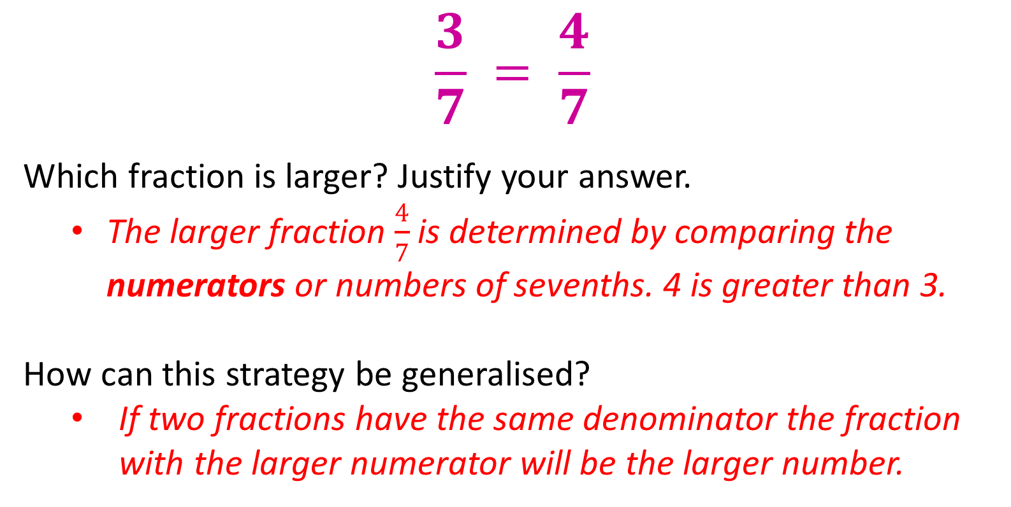
24
7
30
Comparing Fractions
Date
EQ – How can we use benchmarks to compare fractions?
Strategy 1
Using numerators
$$\frac{3}{7} = \frac{4}{7}$$
Which fraction is larger? Justify your answer.
  The larger fraction $\frac{4}{7}$is determined by comparing the numerators or numbers of sevenths. 4 is greater than 3.
How can this strategy be generalised?
  If two fractions have the same denominator the fraction with the larger numerator will be the larger number.
Notes:
This activity engages students in comparing fractions using four strategies other than equivalence. Students are expected to explain how and why the strategies work and justify when and why it is most appropriate to use each strategy.
Explain to students they are now going to explore four strategies to compare fractions. The aim is to choose, use and justify the most efficient strategy to determine which is the larger or smaller in a pair of fractions.

Slide 4
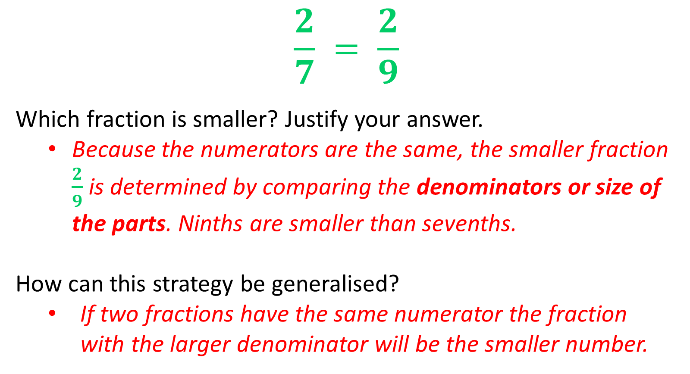
24
7
30
Comparing Fractions
Date
EQ – How can we use benchmarks to compare fractions?
Strategy 2
Using denominators
$$\frac{2}{7} = \frac{2}{9}$$
Which fraction is smaller? Justify your answer.
  Because the numerators are the same, the smaller fraction $\frac{2}{9}$ is determined by comparing the denominators or size of the parts. Ninths are smaller than sevenths.
How can this strategy be generalised?
  If two fractions have the same numerator the fraction with the larger denominator will be the smaller number.

Slide 5


Slide 6
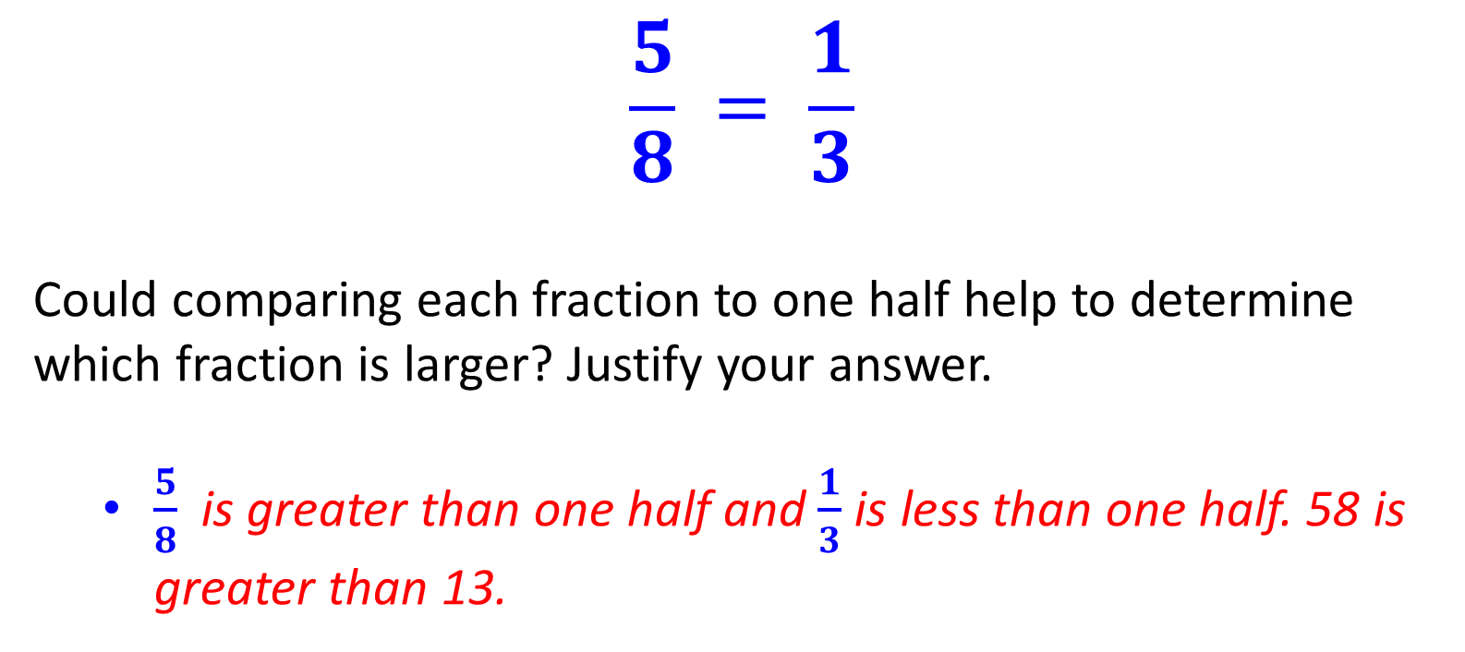
24
7
30
Comparing Fractions
Date
EQ – How can we use benchmarks to compare fractions?
Strategy 2
Using a benchmark
$$\frac{5}{8} = \frac{1}{3}$$
Could comparing each fraction to one half help to determine which fraction is larger? Justify your answer.
  $\frac{5}{8}$is greater than one half and $\frac{1}{3}$ is less than one half. 58 is greater than 13.

Slide 7
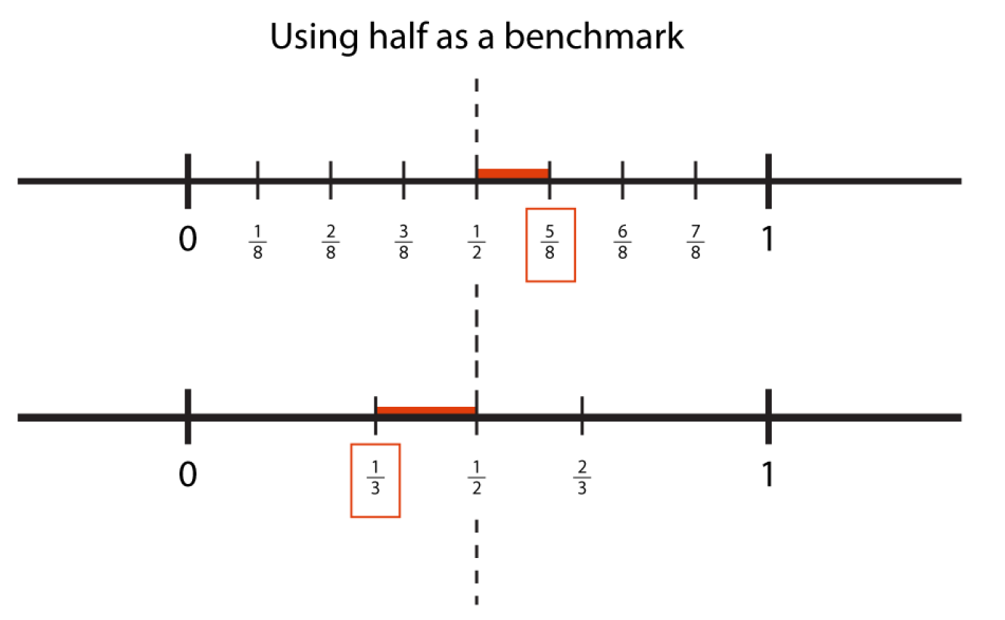
Notes:
Show students the diagram: Using half as a benchmark, to support students to visualise the strategy. Explain that a benchmark is a point of comparison.

Slide 8
How can this strategy be generalised?
  A benchmark of one may be used to compare two fractions when both fractions are a unit fraction less than one. The fraction with the smaller denominator will be further away from one and therefore the smaller fraction.

Slide 9
Benchmark Match
Provide pairs of students with Activity 3: Strategies to compare fractions and a pair of scissors to create a set of cards.
Ask students to decide and mark which of the two fractions on each card is larger. For each card, students choose and use either a benchmark of one half or a benchmark of one to justify their answers.

Slide 10
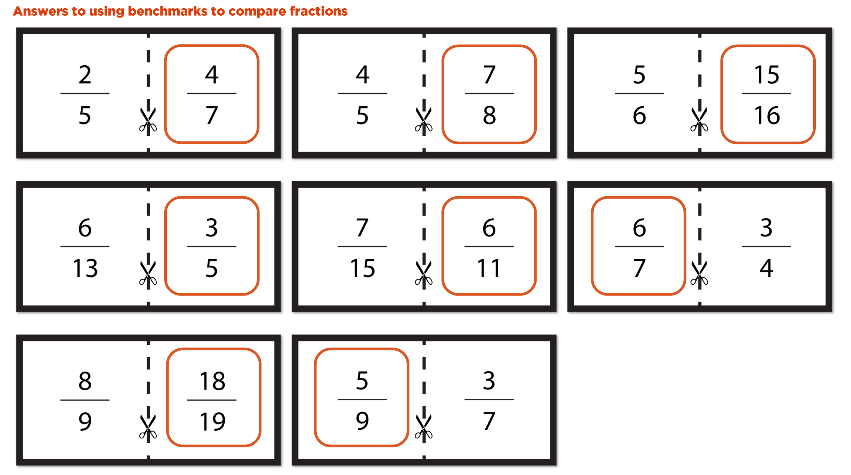
Answers

Slide 11
Benchmark Match
Ask students to cut each card into two individual fractions and place the fractions in order from smallest to largest. To determine and justify the order, students choose and use either a benchmark of one half or a benchmark of one.

Slide 12
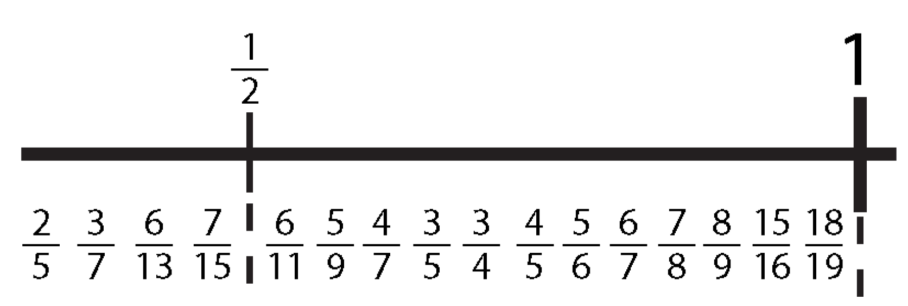
Answers

Slide 13

Task
$$\frac{13}{15} = \frac{4}{5}$$
Which fraction is larger?
  Justify your choice using your understanding of equivalent fractions.
Can you explain when this strategy is most useful?
  The strategy is only useful when comparing fractions where one fraction has a denominator that is a multiple of the denominator of the other fraction.
Notes:
The next part of the activity requires students to explore equivalence as an additional strategy to compare fractions. It is not necessary for students to use a prescriptive method for setting out their calculations. The emphasis should be on students conveying their thought processes using clear setting out and ensuring any equations they construct are true.
Students may recognise the denominator of 15 as a multiple of 5, which is the other denominator. They identify the multiplicative relationship between denominators and convert 4/5 to 12/15 by multiplying the numerator and denominator by 3.The fractions 13/15 and 12/15 can then be easily compared.

Slide 14
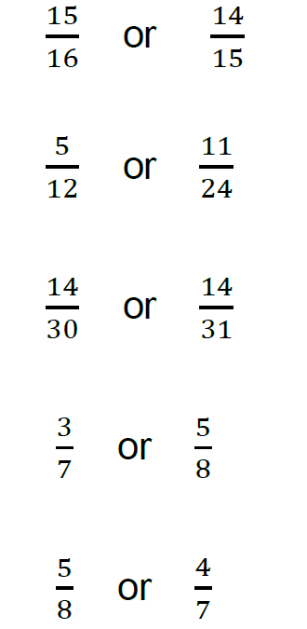
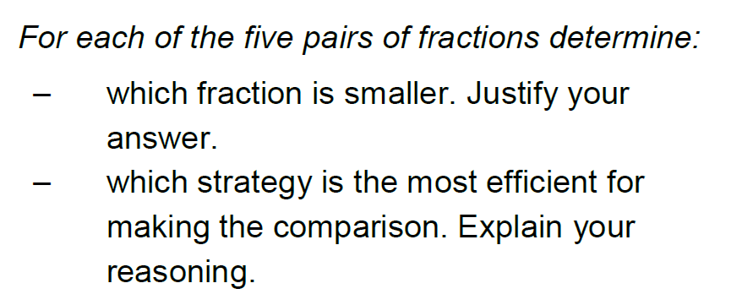
Task

Slide 15
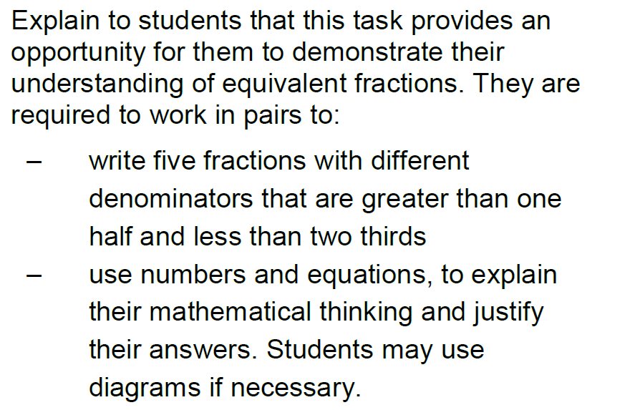
Task: Extension

